Slide 1
CAP-316
Computing Professional Practices and Ethics
Key Privacy and Anonymity Issues
Dr. Narinder Singh Rana
Associate Professor – School of Computer Application
Lovely Professional University

Slide 2
Key Privacy and Anonymity Issues
Data Breaches
Electronic Discovery
Consumer Profiling
Workplace Monitoring
Advanced Surveillance Technology
Dr. Narinder Singh Rana, Lovely Professional University

Slide 3
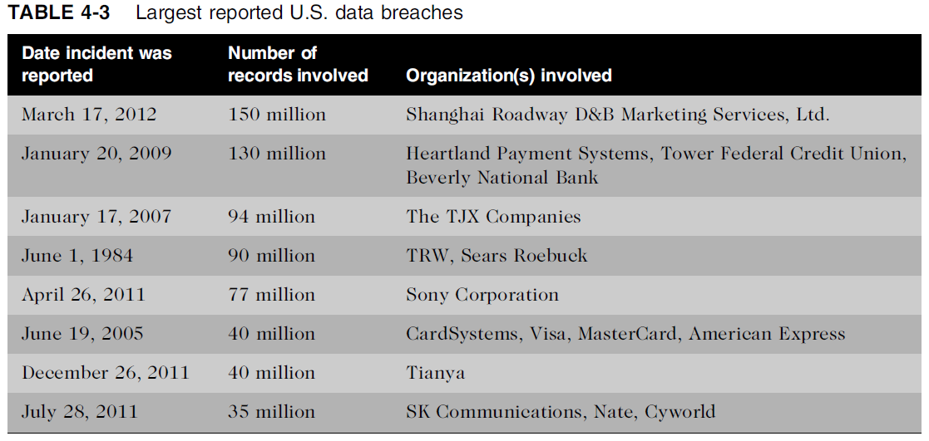
Dr. Narinder Singh Rana, Lovely Professional University

Slide 4
Advanced Surveillance Technology
Camera Surveillance
Vehicle Event Data Recorders
Stalking Apps
Dr. Narinder Singh Rana, Lovely Professional University

